Slide 1

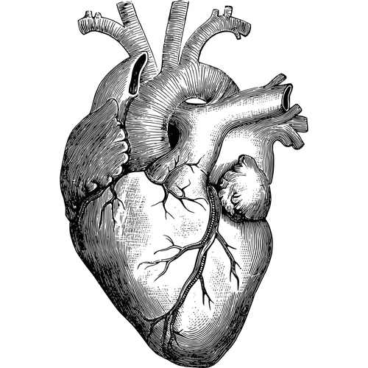
* PULSE OF LIFE *
BATCH NUMBER: 12
BATCH MEMBERS:
T. SRAVAN -22N31A66H3
Y.SASIDHAR REDDY-22N31A66J7
RAGHAVENDRA-22N31A66E9
GUIDANCE BY : Mr. Md. Azhar
DESIGNATION:ASSISTANT PROFESSOR
1

Slide 2
CONTENT:
1.ABSTRACT
2.INTRODUCTION
3.EXISTING SYSTEM
4.LIMITATIONS
5.PROPOSED SYSTEM
6.ADVANTAGES
7.REQUIREMENTS
8.UML DIAGRAMS
9.ER DIAGRAM
10.REFERENCES
2

Slide 3
ABSTRACT:
Nowadays, heart disease is a common and frequently present disease in the human body and it’s also hunted lots of humans from this world. Doctor’s and clinical research said that heart disease is not a suddenly happened disease it’s the cause of continuing irregular lifestyle and different body’s activity for a long period after then it’s appeared in sudden with symptoms. After appearing those symptoms people seek for a treatment in hospital for different test and therapy but these are little expensive. So, awareness before getting appeared in this disease people can get an idea about the patient condition from this research result. This research collected data from different sources and split that data into two parts like 80% for the training dataset and the rest 20% for the test dataset. These algorithms are namely Logistic Regression Classifier gave the same and better accuracy as other algorithms. This paper proposes a development that which factor is vulnerable to heart disease given basic prefix like Age, Gender, Blood Pressure, Cholesterol Level, etc.
3

Slide 4
Introduction:
Pulse of life – your personalized Heart Health Predictor.
The “Pulse of life” represents an advanced yet user-centric website .This innovative tool endeavours to assess an individual’s risk of heart disease based on comprehensive user provided data.
Designed with user convenience, Pulse of life streamlines the process of collecting vital health-related information .Through intuitive interfaces and intelligent data handling , user.
Can effortlessly input diverse parameters such as demographic details , medical history , lifestyle habits.
It will predict the risk which is high or low by logistic regression machine learning algorithm.
4

Slide 5
EXISTING SYSTEM:
Ada is an AI-powered health platform that assists users in assessing symptoms,understanding potential health conditions, and providing personalized health guidance.
Fitbit and similar wearable devices offer health tracking features that monitor heart rate, activity levels, and sleep patterns, providing users with insights into their overall health and potential risk factors.
Google Health has been involved in various health-related studies and projects, utilizing data analytics and machine learning to understand health patterns and risks within populations.
Mayo Clinic offers an online symptom checker that assists users in assessing the symptoms and provides potential health condition suggestions based on entered information.
5

Slide 6

LIMITATIONS :
Accuracy and Reliability : The predictions might not always be 100% accurate.
Data Limitations : The accuracy of predictions heavily depends on the quality and quantity of input data.
Scope and Generalization : This might not encompass all symptoms related to heart disease.
User Variability: Individual health conditions
and responses to risk factors can vary significantly.
6

Slide 7
PROPOSED SYSTEM:
We worked on heart disease dataset obtained from UCI( University of California at Irvine) repository. We split the data into two parts like 80% for training dataset and the rest for test dataset.
The website will utilize predictive models to analyze various user inputs.
The proposed system will adhere to strict data privacy regulations to ensure the secure handling and storage of user’s sensitive health information.
Based on the risk assessment ,the website will provide personlized recommendations for lifestyle changes, diet modifications .
Capability to track changes in risk assessments over time , allowing users to monitor improvements resulting from medical interventions.
7

Slide 8
ADVANTAGES:
High Accuracy:Machine learning algorithms can achieve remarkable accuracy in diagnosing heart diseases, reducing the risk of misdiagnosis and improving patient outcomes.
Early Detection:These algorithms excel in early disease detection, allowing for timely interventions and preventive measures to be taken, potentially saving lives.
Reduce the healthcare cost and time complexity.
Personalized Treatment Plans:Machine learning enables the development of personalized treatment plans
8

Slide 9

REQUIREMENTS:
SOFTWARE REQUIREMENTS
OS: Windows 7
FRONT END: HTML 5, CSS 3 .
BACK END : PYTHON .
HARDWARE REQUIREMENTS
HARD DISK:512GB(MIN)
RAM:8GB(MIN)
PROCESSER:intel i5 or higher
Keyboard, monitor
9

Slide 10
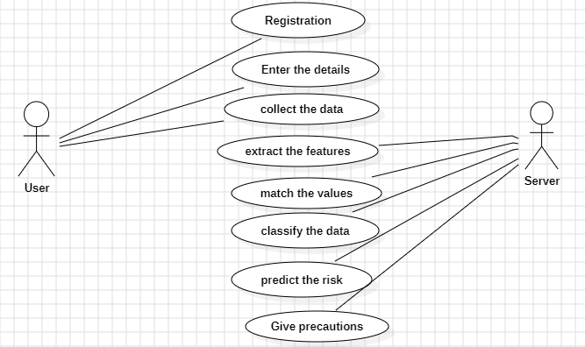
UML(unified modeling language) DIAGRAMS:
ER DIAGRAM :
USECASE DIAGRAM :

Slide 11
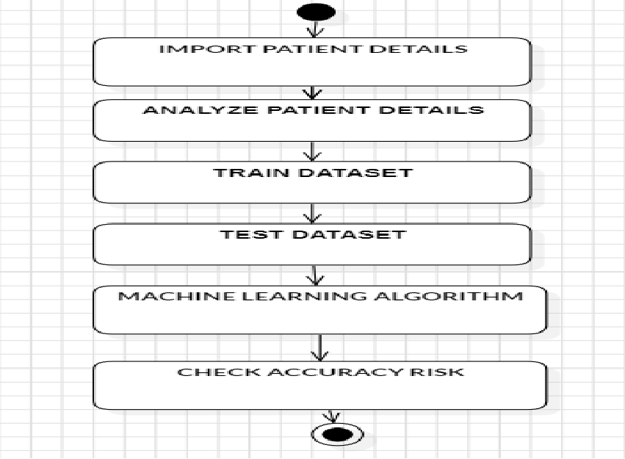
ACTIVITY DIAGRAM:

Slide 12
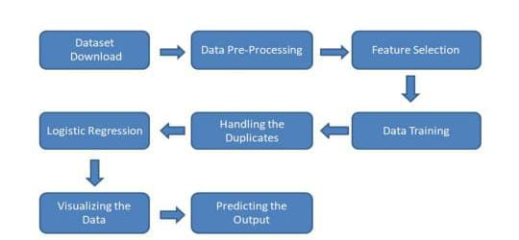
DATA FLOW DIAGRAM :
B
registration
risk

Slide 13
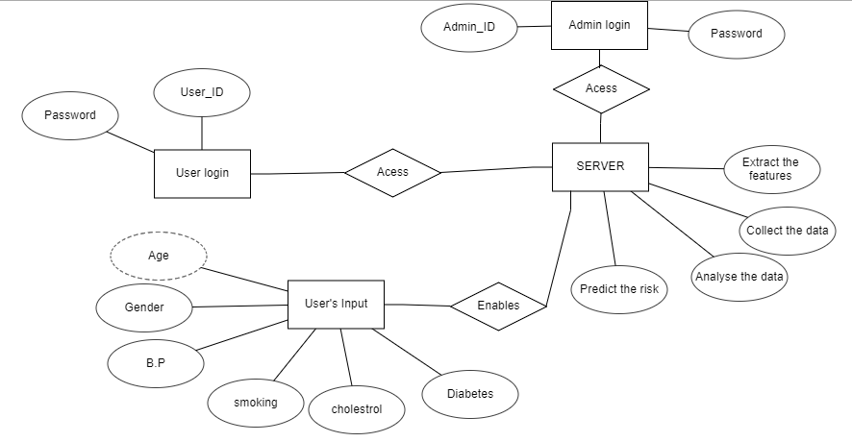
ER DIAGRAM
ER DIAGRAM:
ER DIAGRAM:
ER DIAGRAM:
ER DIAGRAM:
ER DIAGRAM:
ER DIAGRAM :

Slide 14
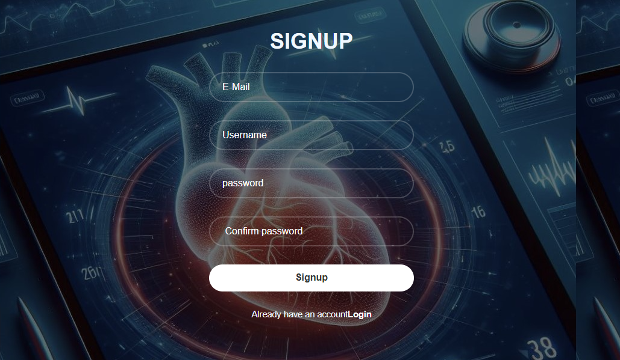
OUTPUT SCREENS :

Slide 15
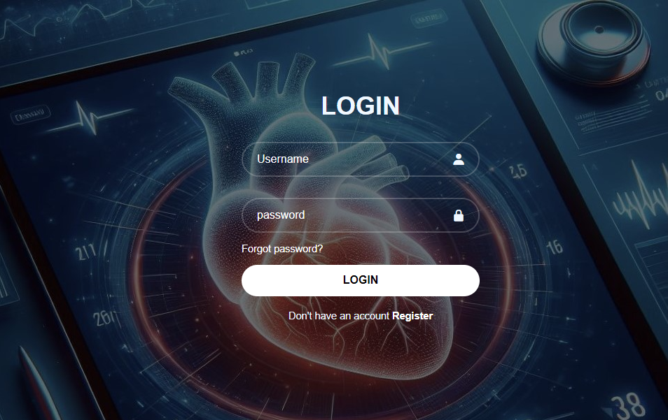
LOGIN PAGE:

Slide 16
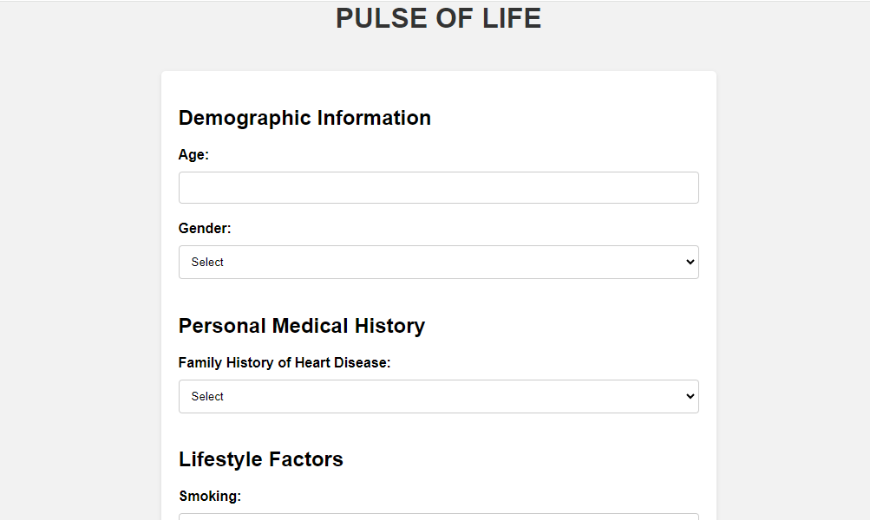
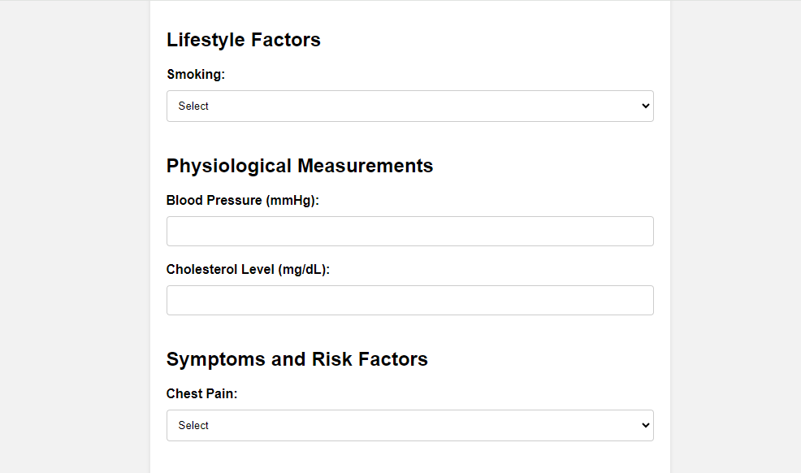
INPUT PAGE :

Slide 17
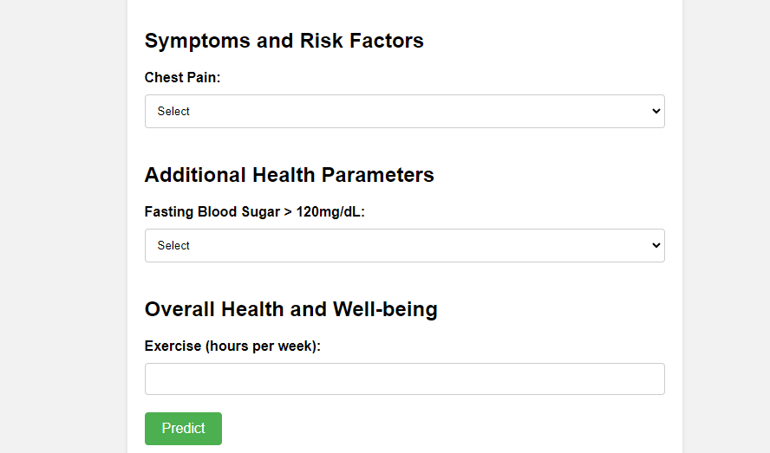
.

Slide 18
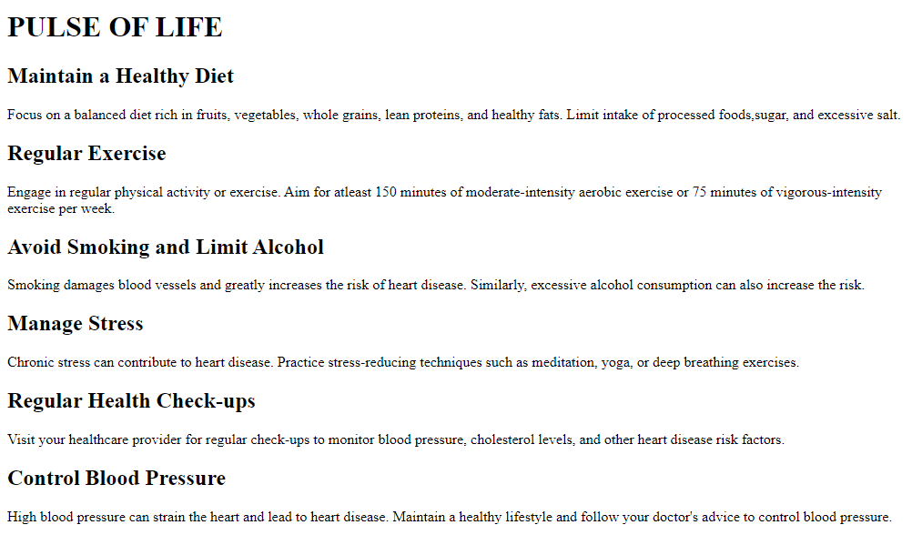
.

Slide 19
REFERENCES:
1.ncbi.nlm.nihgov
https//www.ncbi.nlm.nih gov/pmc/articles/PMC10258084/&ved=2ahUKEwjn0Ifzsr6EAxX17zgGHW1hC7gQFnoECCIQAQ&usg=AOvVaw0vfN3PGIyZ4338hLRYUyRw
2.iopscience
https://www.google.com/url?sa=t&source=web&rct=j&opi=89978449&url=https://iopscience.iop.org/article/10.1088/1757-899X/1022/1/012072/pdf&ved=2ahUKEwjn0Ifzsr6EAxX17zgGHW1hC7gQFnoECCMQAQ&usg=AOvVaw35ybsKmhZC5lT_VfWEiu_f
10

Slide 20

Conclusion
Empowering Health Awareness and Disease Prevention.
Machine learning (ML) can help predict heart disease by analyzing medical data like blood pressure, age, and cholesterol levels, which can lead to early detection and prevention
11

Slide 21

12

